Slide 1
Perceptron & Introduction to Neural Networks

Slide 2
What is Perceptron?
The term perceptron, in ML, refers to an algorithm for supervised learning of binary classifiers
Perceptron is linear classifier
It makes its predictions based on a linear predictor function combining a set of weights with the feature vector
Perceptron is binary classifier
There should be only 2 categories for classification
A neural network is an interconnected system of perceptrons
Perceptrons are the foundation of any neural network

Slide 3

Little Bit History
First introduced by American psychologist, Frank Rosenblatt in 1957 at Cornell Aeronautical Laboratory
Rosenblatt was heavily inspired by the biological neuron and its ability to learn
Rosenblatt’s Perceptron:
It was able to work only with linearly separable data points
X₁
X₂
P
…
Y
X_{n}
PC: Towardsdatascience

Slide 4
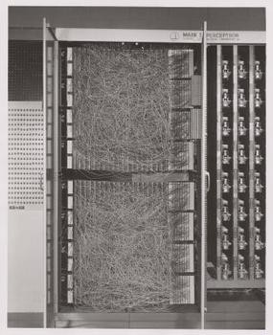
History Continued
Rosenblatt’s idea was to create a physical machine that behaves like a neuron
However, it’s first implementation was a software that had been tested on the IBM 704
Eventually, the software was implemented into custom-built hardware with the intention to use it for image recognition
PC: Towardsdatascience

Slide 5
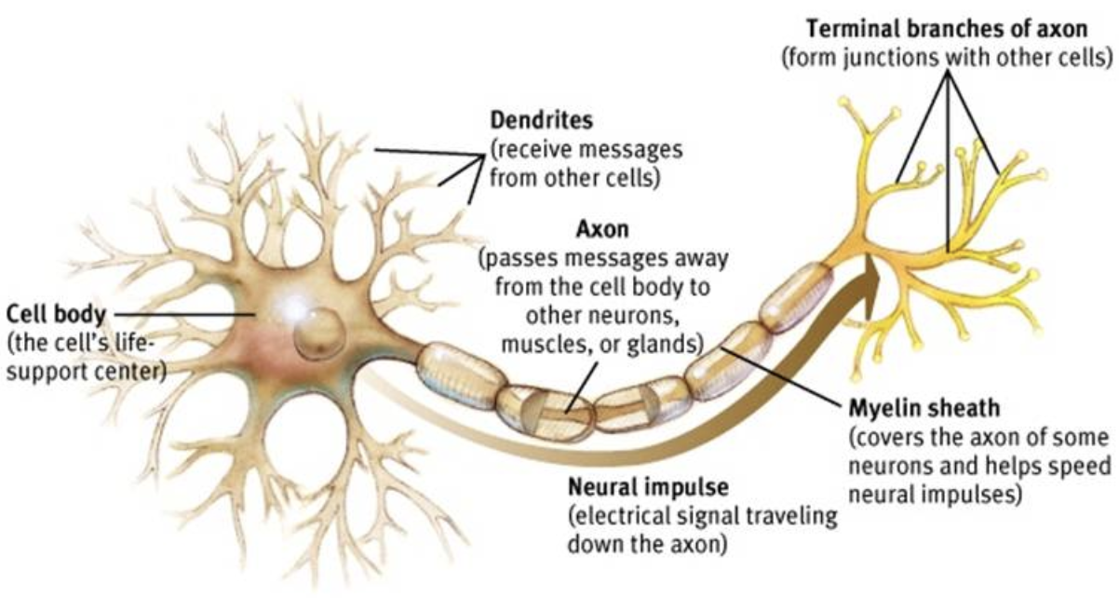
The biological Motivation of Perceptron
Binary Inputs from other Neurons
Binary Outputs to other Neurons
Binary Inputs from other Neurons
PC: Medium
In the biological neuron, the point of this cell is to take in some input (in the form of electrical signals in our brains), do some processing, and produce some output (also an electrical signal).

Slide 6
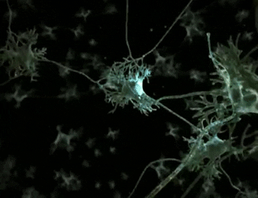
The flow of electric signals through neurons in human brain
PC: KDNuggets

Slide 7
Human Neurons – A Quick Overview
An individual neuron accepts inputs, usually from other neurons, through its dendrites
The dendrites connect with other neurons through a the synapse — that assigns a weight to a particular input
Then, all of these inputs are considered together when they are processed in the cell body
All-or-none behavior of neurons
If the combination of inputs exceeds a certain threshold, then an output signal is produced
In this case, output travels to other neurons along the axon to the axon terminals
If the combination falls short of the threshold, then the neuron doesn’t produce any output

Slide 8
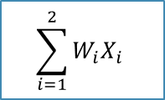
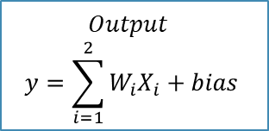
How does Perceptron mimic human neurons?
W₁, W₂, & W₃ are Weights
X₁
W₁
Neuron
X₁, X₂, & X₃ are numerical inputs
W₂
Y
X₂
W₃
$$Output$$
$$y=\sum_{i=1}^{2}{W_{i}X_{i}+bias}$$
$$\sum_{i=1}^{2}{W_{i}X_{i}}$$
X₃

Slide 9
What if we want the Perceptron’s output to be within a specific range i.e. 0 & 1?
Different kinds of activation functions:
Hyperbolic Tangent: used to output a number from -1 to 1.
Logistic Function: used to output a number from 0 to 1.
X₁
W₁
Neuron
Bias
W₂
a()
Y
X₂
W₃
Activation Function
X₃
An activation function is a function that converts the input given (the input, in this case, would be the weighted sum and the bias) into a certain output based on a set of rules.

Slide 10
A perceptron without activation function can only perform linear transformation on the inputs and hence it is less powerful…!

Slide 11
Activation Functions
The activation/transfer function defines the output of a perceptron given an input or set of inputs
It maps the resulting values in between 0 to 1 or -1 to 1 etc.
The Activation Functions can be basically divided into 2 types-
Linear Activation Function
Non-linear Activation Functions
Through activation function, the nonlinear separation of data points is also possible.

Slide 12
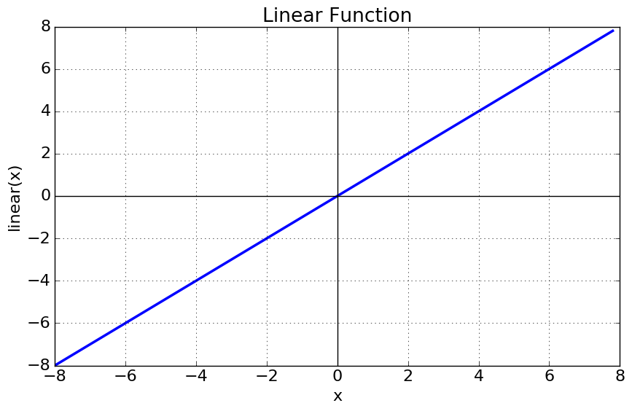
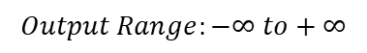
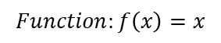
Linear Activation Function
As you can see the function is a line or linear
Therefore, the output of the functions will not be confined between any range
$$Function:f\left(x\right)=x$$
$$Output Range:−∞ to+∞$$
It doesn’t help in the presence of complex data that is usually fed to neural networks.
PC: Towardsdatascience

Slide 13
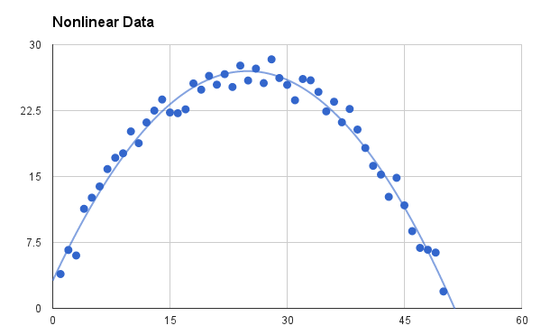
Non-linear Activation Function
The Nonlinear Activation Functions are the most used activation functions
Nonlinearity helps to make the graph look something like below
Terminologies:
1. Derivative or Differential:
Change in y-axis w.r.t. change in x-axis
It is also known as slope
2. Monotonic function:
A function which is either entirely non-increasing or non-decreasing
PC: Towardsdatascience

Slide 14

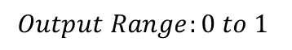
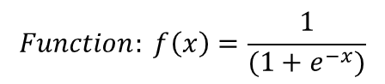
Sigmoid or Logistic Activation Function
The Sigmoid Function results in a S-shape curve as below
It is especially used for models where we have to predict the probability as an output (0 <= P <= 1)
The function is differentiable meaning we can find the slope of the sigmoid curve at any two points
The function is monotonic but not derivative
The logistic sigmoid function can cause a neural network to get stuck at the training time
Softmax function : a more generalized logistic activation function which is used for multiclass classification
PC: Towardsdatascience
$$Function: f\left(x\right)=\frac{1}{(1+e^{−x})}$$
$$Output Range:0 to 1$$

Slide 15
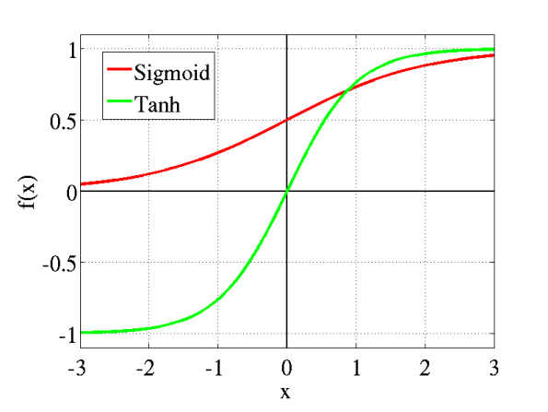
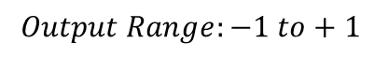
Tanh or hyperbolic tangent Activation Function
The tanh is also like logistic sigmoid except it is symmetric around the origin
The advantage is that the negative inputs will be mapped strongly negative and the zero inputs will be mapped near zero in the tanh graph
The function is differentiable
The function is monotonic while its derivative is not monotonic
The tanh function is mainly used classification between two classes
PC: Towardsdatascience
$$Function:tanh\left(x\right)=2∗Sigmoid\left(2x\right)−1$$
$$Output Range:−1 to+1$$

Slide 16

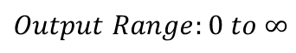
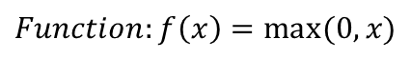
ReLU (Rectified Linear Unit) Activation Function
The ReLU function is another non-linear activation function that has gained popularity in the deep learning domain
PC: Towardsdatascience
As you can see, the ReLU is half rectified (from bottom) i.e., f(z) is zero when z is less than zero and f(z) is equal to z when z is above or equal to zero
The function and its derivative both are monotonic
$$Function:f\left(x\right)=max⁡(0,x)$$
$$Output Range:0 to ∞$$

Slide 17
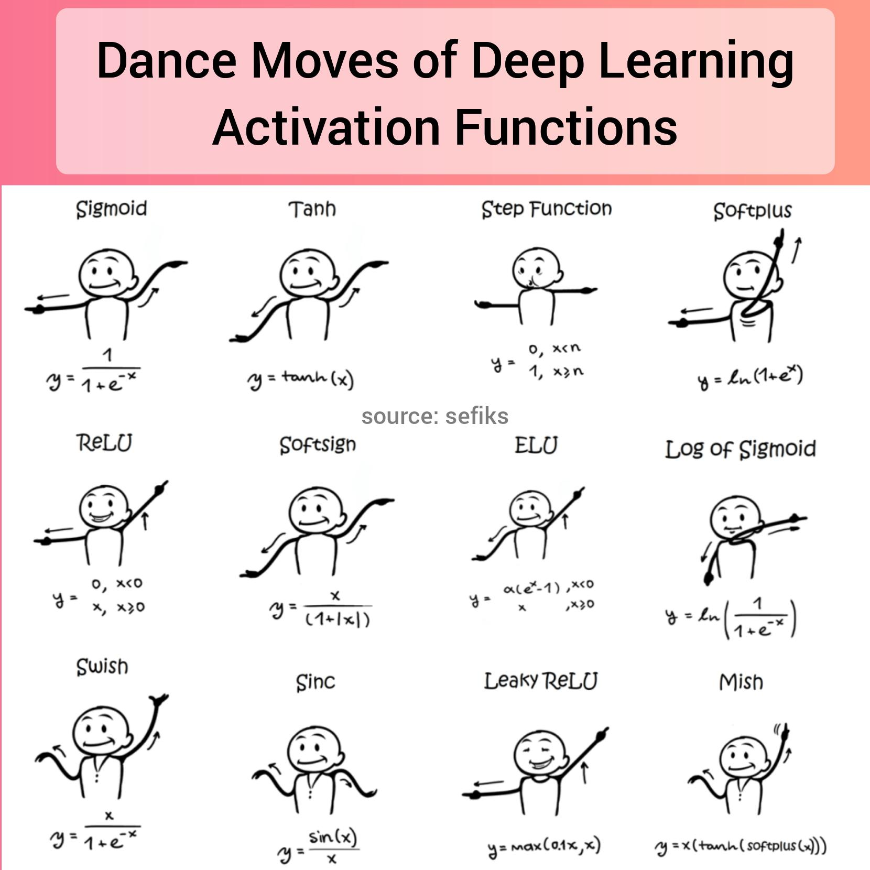
PC: Reddit

Slide 18
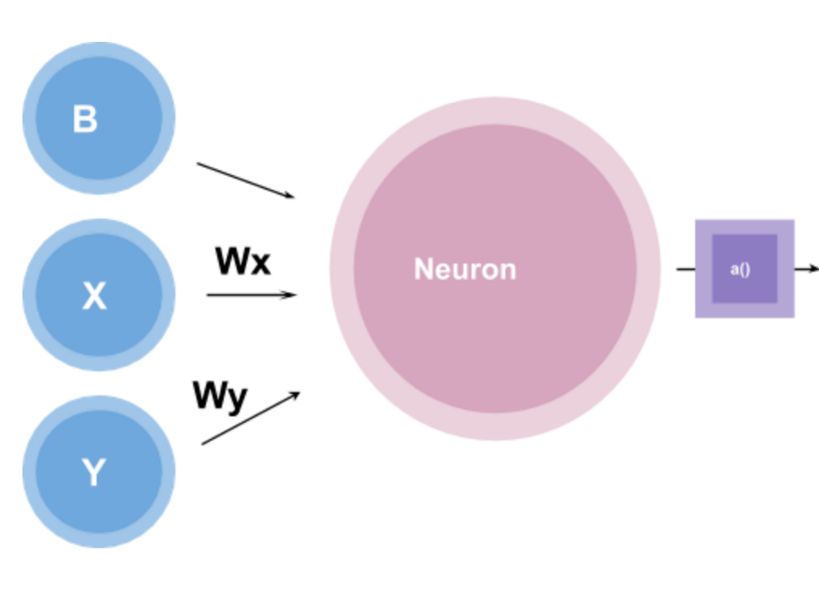
Binary Classification using Perceptron
Let’s take a simple perceptron, given inputs x and y, which are multiplied with the weight w as w*x and w*y
A bias is also given
PC: Towardsdatascience

Slide 19
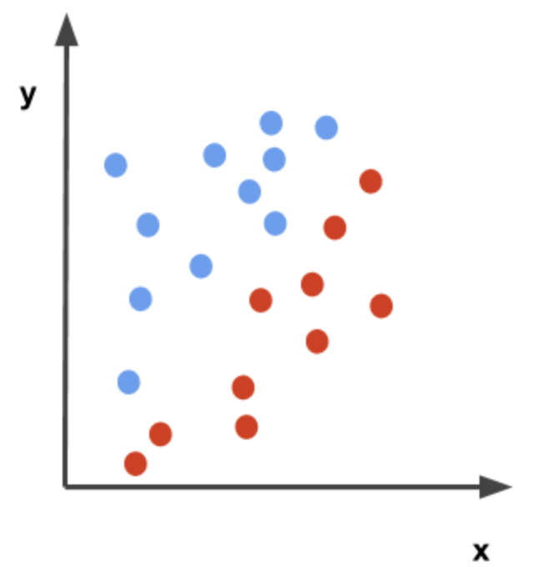
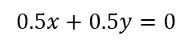
Binary Classification using Perceptron contd.
Our goal is to separate the data plotted below so that there is a distinction between the blue dots and the red dots
A perceptron can create a decision boundary for a binary classification as follows
Lets say, wx = 0.5, wy = +0.5, and b = 0
Then, the function for the perceptron will be
Let’s suppose that the activation function, in this case, is a simple step function that outputs either 0 or 1
$$0.5x+0.5y=0$$
PC: Towardsdatascience

Slide 20
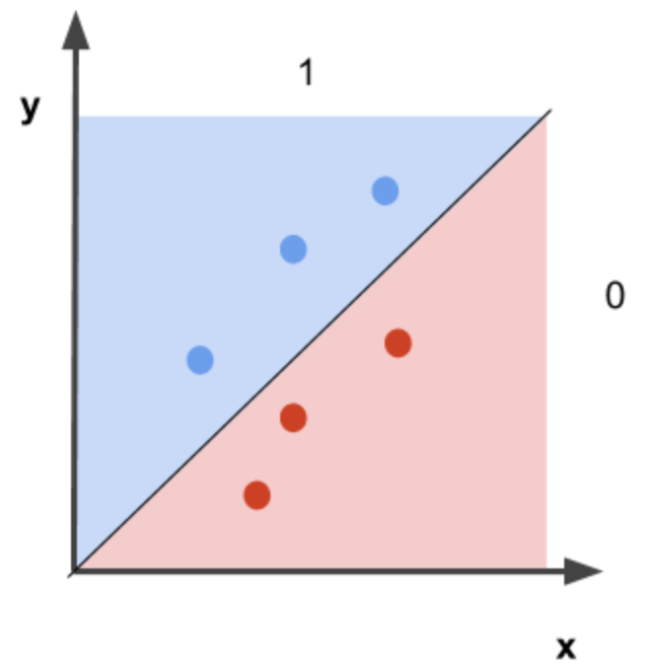
Binary Classification using Perceptron contd.
The perceptron function will then label the blue dots as 1 and the red dots as 0
In other words,
if 0.5x + 0.5y => 0, then 1
if 0.5x + 0.5y < 0, then 0
Therefore, the function 0.5x + 0.5y = 0 creates a decision boundary that separates the red and blue points
PC: Towardsdatascience

Slide 21
Single Layer Perceptron
The neuronal model we have just discussed is also known as a perceptron.
The perceptron is the simplest form of a neural network used for the classification of patterns said to be linearly separable.
Basically, it consists of a single neuron with adjustable synaptic weights and bias.
Now we will look at a method of achieving learning in our model we have formulated.

Slide 22
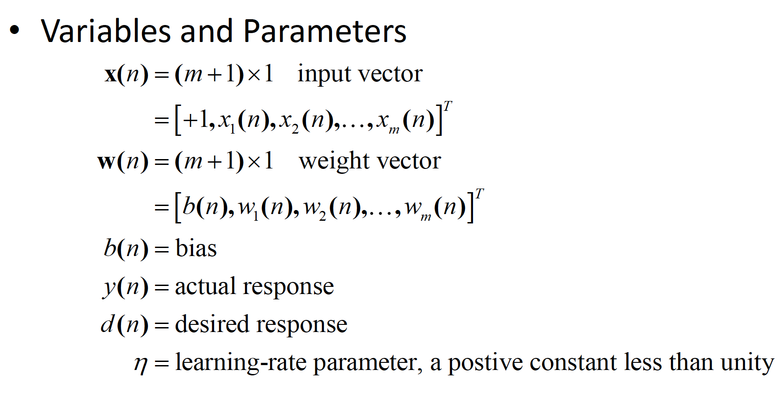
Perceptron Convergence (Learning)
Algorithm

Slide 23
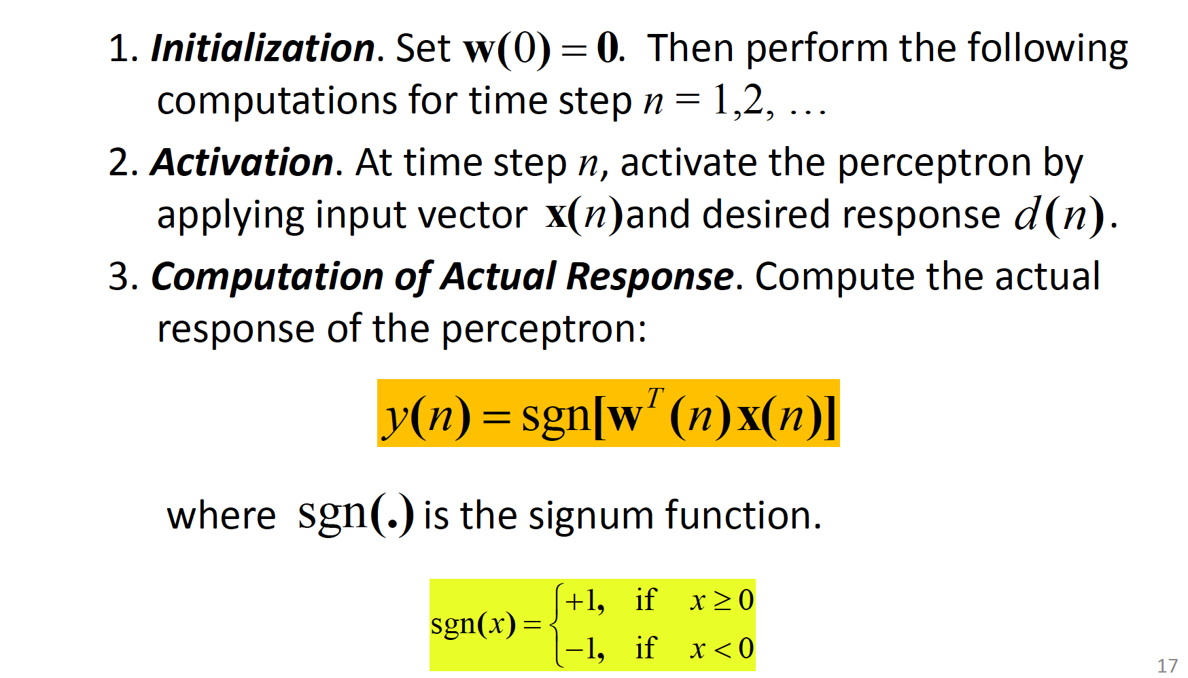
Perceptron Convergence (Learning)
Algorithm

Slide 24
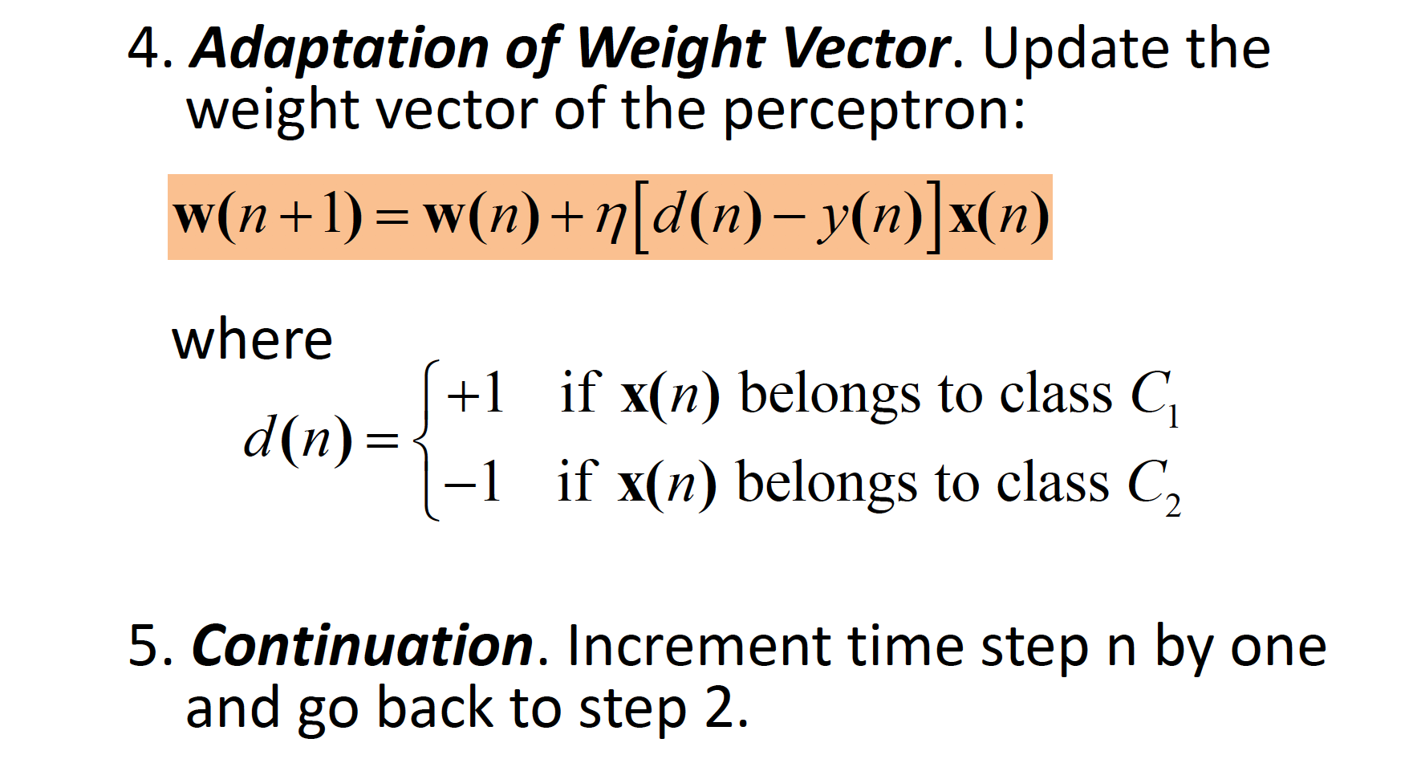
Perceptron Convergence (Learning)
Algorithm

Slide 25

Decision Boundary
The hyper-plane
m
x₂
åw_{i} x_{i} + b = 0
i=1
or
w₁x₁ + w₂ x₂ + b = 0
Class C
1
0
x₁
is the decision boundary for a two class classification problem.
Class C₂
19

Slide 26
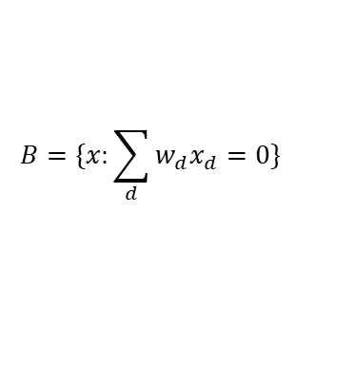
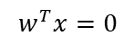
Decision Boundary
A perceptron is more specifically a linear classification algorithm, because it uses a line to determine an input’s class
If we draw that line on a plot, we call that line a decision boundary
The decision boundary is precisely where the sign of the activation, a changes from -1 to +1
We can rewrite this equation in terms of dot product between the two vectors w = <w₁, w₂,… w_{D}> and x = <x₁, x₂, … x_{D}>
The two vectors only has a zero dot product if and only if they are perpendicular
Thus, the decision boundary is simply the plane perpendicular to w.
$$B=\{x:\sum_{d}{w_{d}x_{d}=0}\}$$
$$\left(x_{i},y_{i}\right) is correctly classified if and only if:y_{i}\left(w^{T}x_{i}\right)>0$$
$$w^{T}x=0$$

Slide 27
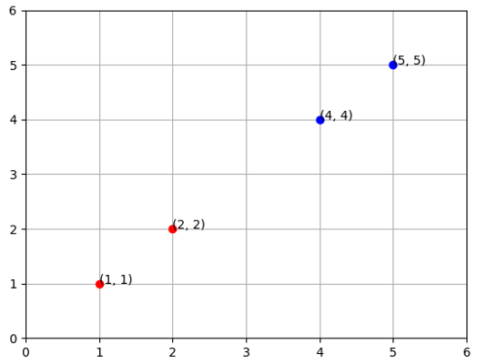
Decision Boundary Example
x | y | Label
1 | 1 | 0
2 | 2 | 0
4 | 4 | 1
5 | 5 | 1
weights: [ 0.2, -0.1]
bias: -0.29
PC: Towardsdatascience

Slide 28
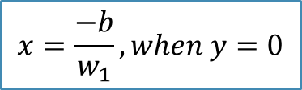
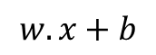
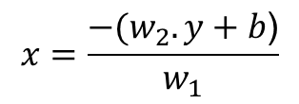
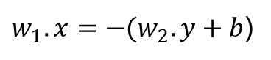
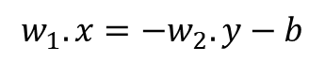
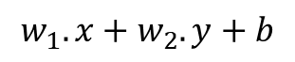
Decision Boundary
The summation of that our perceptron uses to determine its output is the dot product of the inputs and weights vectors, plus the bias
When our inputs and weights vectors of are of 2-dimensions, the long form of our dot product summation looks like this:
That now looks an awful lot like the standard equation of a line
We can now solve for two points on our graph, the x-intercept:
$$w.x+b$$
$$w_{1}.x+w_{2}.y+b$$
$$w_{1}.x=−w_{2}.y−b$$
$w_{1}.x=−{(w}_{2}.y+b$)
$$x=\frac{−{(w}_{2}.y+b\text{)}}{w_{1}}$$
$$x=\frac{−b}{w_{1}},when y=0$$

Slide 29
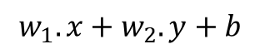

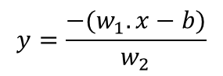
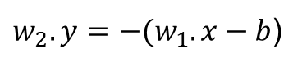
Decision Boundary contd.
And the y-intercept:
With those two points, we can find the slope, m:
$$w_{1}.x+w_{2}.y+b$$
${w_{2}.y=−(w}_{1}.x−b$)
$$y=\frac{−(w_{1}.x−b)}{w_{2}}$$
$$y=\frac{−b}{w_{2}},when x=0$$
point₁ = (x₁, y₁) = (0, -b / w₂)
point₂ = (x₂, y₂) = (-b / w₁, 0)

Slide 30
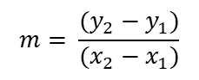
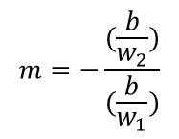
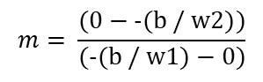
Decision Boundary contd.
$$m= \frac{(y_{2}−y_{1})}{(x_{2}−x_{1})}$$
$$m= \frac{(0−\text{−(}\text{b}\text{ / }\text{w}\text{2)})}{(\text{−(}\text{b}\text{ / }\text{w}\text{1)}−0)}$$
$$m=−\frac{(\frac{b}{w_{2}})}{(\frac{b}{w_{1}})}$$
Now, we have the two values we need to construct our line in slope-intercept form:
slope = -(b/w₂)/(b/w₁)
y-intercept = -b/w₂
$$y=−((b/w_{2}))/(b/w_{1}))x+(−b/w_{2}), like y=mx+c$$

Slide 31
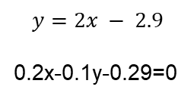
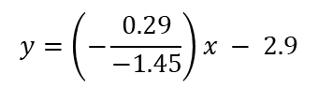
Decision Boundary contd.
weights: [ 0.2, -0.1]
bias: -0.29
$$y=−((−0.29/−0.1))/(−0.29/0.2))x+(−(−0.29)/−0.1)$$
$$y=\left(−\frac{0.29}{−1.45}\right)x − 2.9$$
$$y=2x − 2.9$$
0.2x-0.1y-0.29=0
Plugging in our numbers from the dataset, we get the above.

Slide 32
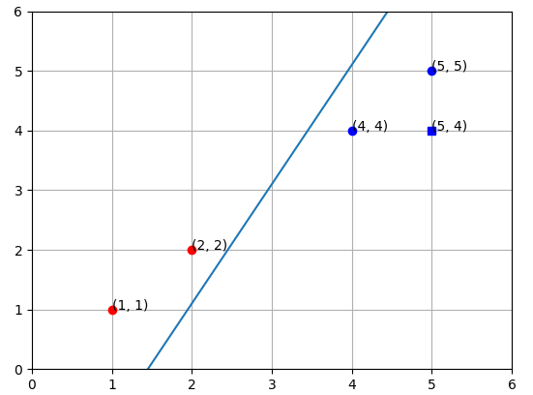
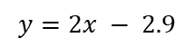
Decision Boundary contd.
$$y=2x − 2.9$$
PC: Towardsdatascience

Slide 33
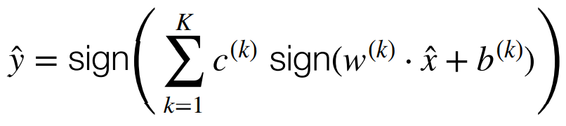
Voted Perceptron Algorithm
Intuition: We want the weight vectors that “survive” a long time to get more say than the weight vectors that are overthrown quickly
Let (w,b)⁽¹⁾, …. (w,b)^{(K)} be the K+1 weight vectors encountered during training, and c⁽¹⁾, …, c^{(K)} be the survival times for each weight vector
Then, the prediction on a test point is:
Though it is guaranteed to generalize better, it is impractical
Need to store weight vectors and their counts, and ask for a growing number of votes in each iteration

Slide 34
Introduction to Neural Networks

Slide 35
What is a Neural Network?
Neural networks are a series of algorithms that mimic the operations of a human brain to recognize relationships between vast amounts of data

Slide 36
Neural Networks Vs. Your Brain
Have you ever wondered how your brain recognizes images? No matter what or how the image looks, the brain can tell that this is an image of a cat and not a dog. The brain relates to the best possible pattern and concludes the result.

Slide 37
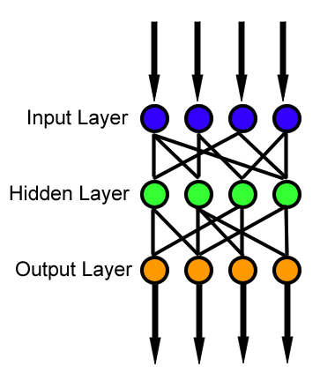
Neural Networks
A neural network is made of artificial neurons that receive and process input data
A neural network process starts when input data is fed to it
Data is then processed via its layers to provide the desired output
The essential building block of a neural network is a perceptron or neuron
PC: Towardsdatascience

Slide 38
Layers in Neural Networks
Input Layer
The Input layer communicates with the external environment that presents a pattern to the neural network
Every input neuron should represent some independent variable that has an influence over the output of the neural network
Hidden Layer
The hidden layer is the collection of neurons which has activation function applied on it
Its job is to process the inputs obtained by its previous layer
Output Layer
The output layer of the neural network collects and transmits the information accordingly in way it has been designed to give
The pattern presented by the output layer can be directly traced back to the input layer

Slide 39
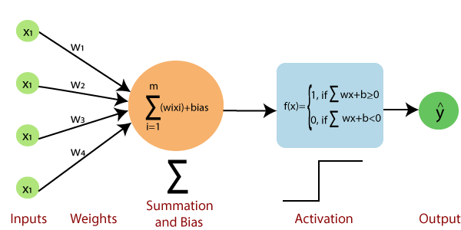
How Neural Networks work
Neural Networks are complex systems with artificial neurons
PC: Section.io

Slide 40
How Neural Networks work contd.
The input layer receives data represented by a numeric value
Once the input layer receives data, it is redirected to the hidden layer
Each input is assigned with weights
The inputs and weights are multiplied, and their sum is sent to neurons in the hidden layer
Bias is applied to each neuron
Each neuron adds the inputs it receives to get the sum
This value then transits through the activation function
The activation function outcome then decides if a neuron is activated or not
An activated neuron transfers information to the other layers
The output layer produces the desired output

Slide 41
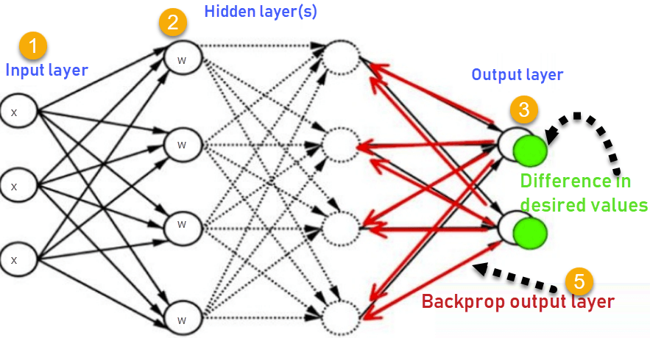
Back Propagation
If the output of a neural network is wrong, backpropagation takes place
While designing a neural network, weights are initialized to each input
Backpropagation means re-adjusting each input’s weights to minimize the errors, thus resulting in a more accurate output
PC: Guru99

Slide 42
Types of Neural Networks
Perceptron
Feed-Forward Neural Network
Radial Basis Function Neural Network
Recurrent Neural Network
Convolutional Neural Network

Slide 43
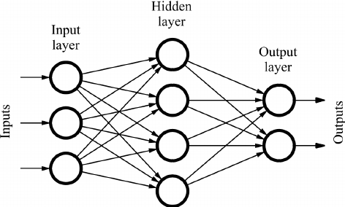
Feed Forward Neural Network
In a feed-forward network, data moves in a single direction
It enters via the input nodes and leaves through output nodes
There is no backpropagation possible here
Applications
Speech Recognition
Facial Recognition
PC: DeepAI

Slide 44
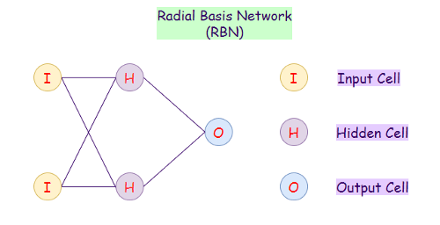
Radial Basis Function Neural Network
RBF networks classify data based on the distance of any centered point and interpolation
RBF networks look for similar data points and groups them
PC: Section.io

Slide 45
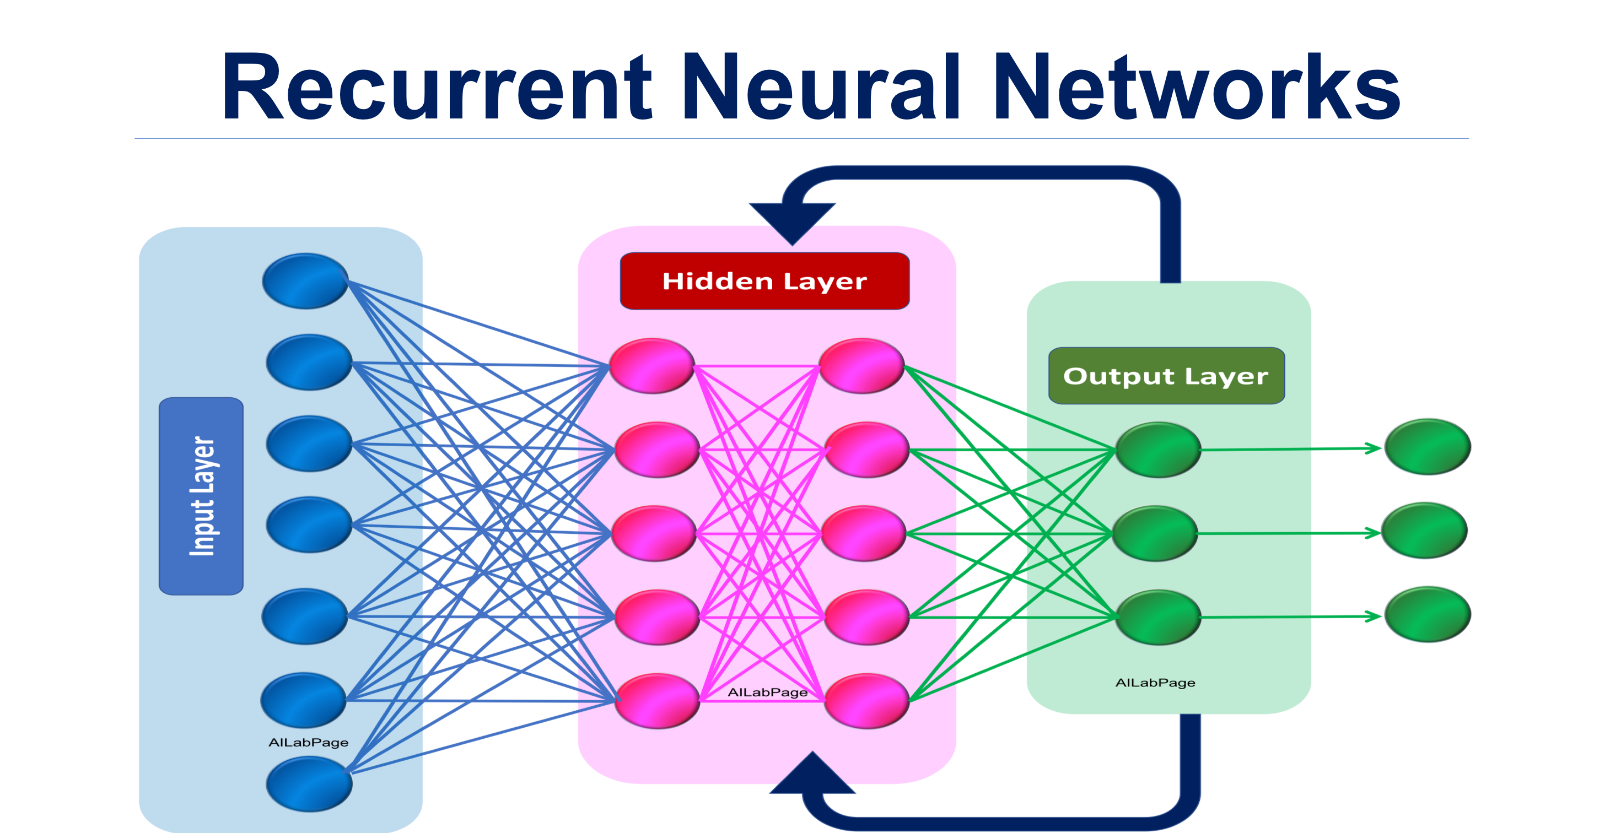
Recurrent Neural Network
A Recurrent Neural Network (RNN) is a network good at modeling sequential data
Sequential data means data that follow a particular order in that a thing follows another
RNN is a feedback neural network
In RNNs, data runs through a loop, such that each node remembers data in the previous step
RNN are used to solve problems in stock predictions, text data, and audio data
PC: Morioh

Slide 46
Convolution Neural Network
Convolutional Neural Networks (CNN) are commonly used for image recognition
CNNs contain three-dimensional neuron arrangement
The first stage is the convolutional layer: Neurons in a convolutional layer only process information from a small part of the visual field
The second stage is pooling: It reduces the dimensions of the features and, at the same time, sustaining valuable data
CNNs launch into the third phase (fully connected neural network) when the features get to the right granularity level
At the final stage, the final probabilities are analyzed and decide which class the image belongs to
CNN is mainly used in signal and image processing

Slide 47
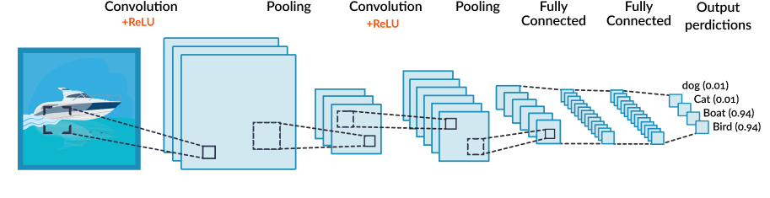
Convolution Neural Network contd.
PC: Section.io

Slide 48

References
What is a Perceptron? – Basics of Neural Networks – Towardsdatascience
What is a perceptron? – Towardsdatascience
Calculate the Decision Boundary of a Single Perceptron - Visualizing Linear Separability – Medium
Introduction to Neural Networks - Section

